Slide 1


Research and Innovation Application process
An overview of the research application process at St James's Hospital
Research & Innovation Team
research@stjames.ie

Slide 2

Topics
Research vs. Non-Research
The New Research & Innovation (R&I) Application Process
Application Pathways
Creating and Completing your R&I application
Submitting your R&I Application
The R&I Review Process
Responding to Feedback
Key Tips

Slide 3
Is my project a research or non-research study
What is a research study?
Designed to generate new, generalisable knowledge.
Aim: to answer a question that is new and unknown, usually involves testing a hypothesis, evaluating an intervention or exploring associations
Results are applicable beyond the population or service
Requires ethical approval
Examples:
Observational research
Randomised controlled trial
Clinical trial
Patient surveys/ interviews to generate new knowledge

Slide 4
Is my project a research or non-research study
What are non-research studies?
Non-research studies do not require ethical approval
No-research studies are registered with QSID
Typically fall into two categories:
  Clinical Audit
  Service Evaluation
Clinical Audit
Aim: To see if current practice meets an agreed and defined standard. The result is binary, yes or no.
Only applicable to a single site or service
Does not require ethics
Service Evaluation
Aim: To assess what is happening in a service, describing current care without comparison to a standard.
Focus on effectiveness, efficiency or acceptability of a service

Slide 5
Summary Table
Feature | Research | Audit | Service Evaluation
Main Aim | Generate new, generalisable knowledge | Measure care against a standard | Understand how a service is working
Generalisable (beyond SJH) | Yes | No | No
Reference point | Research question | Predefined standard/guideline | No standard — describes current service
Ethics approval | Required | Not Required | Not Required
Governance | Ethical approval + Hospital R&I Approval | QSID Registration | QSID Registration
Example | Retrospective chart Review to see if patients on one medication had better outcomes than another Patient survey on unmet needs Randomised controlled trial on efficacy of an intervention | Checking compliance with infection control guidelines, Auditing compliance with antibiotic prescribing guidelines | Patient satisfaction survey Retrospective Chart Review to check compliance with allergy documentation policy Reviewing referral patterns to see how many patients are seen within 6 weeks

Slide 6

The New R&I Application Process

Slide 7

Finding the R&I application
The R&I application is available:
  Internally on the R&I intranet page
  Externally on the R&I Webpage
  Apply directly using this link: R&I Infonetica Platform

Slide 8
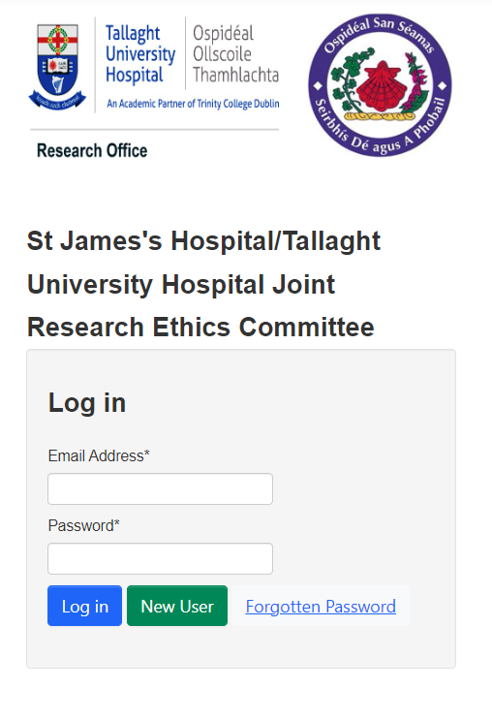
Logging in to your Infonetica account
If you have submitted an application to the Joint Research Ethics Committee (JREC), you already have an Infonetica account that can be used for your R&I applications!
If you are a new user, please sign up using your institutional email.

Slide 9

Research in SJH
All research taking place in SJH requires:
Ethical Approval – from either:
  Joint Research Ethics Committee (JREC)
  National Research Ethics Committee (NREC),
  Clinical Trial Information System (CTIS)
  University/ Institutional Ethics
Hospital approval – from the R&I office (ethical approval must be in place before hospital approval can be granted)
Before your project can begin you must have ethical approval AND hospital approval.
The R&I application is mandatory.

Slide 10
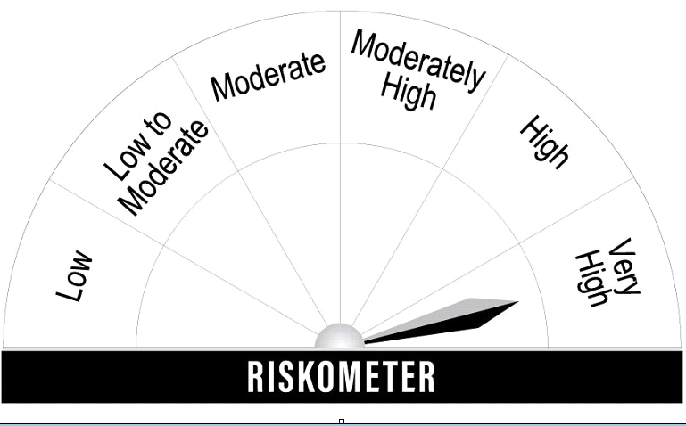
Research Risk and Ethical Approvals
R&I approval can be granted for low-risk research projects such as staff surveys with university or institutional level ethics in place.
High risk research studies such as clinical trials and medical device trials require NREC approval and/ or CTIS approval to be in place before R&I approval will be granted.
Any non-trial research involving SJH patients or patient data must have ethical approval from JREC in place before the R&I office can approve the project.

Slide 11
Research Risk and Ethical Approvals
Patient Interview
Observational Study
Retrospective Chart Review
Medical Device Trial Not Subject to MDR (has CE Mark)
Patient Survey
Medical Device Trial Subject to MDR (no CE Mark)
Staff Interviews
Clinical Trial with medicinal Product
Staff Survey

Slide 12

Application Pathways
Pathway One
Pathway Two
Your application Pathway will be determined by the type of research planned and the type of ethical approval required

Slide 13
Pathway 1
Pathway 1 is for projects requiring JREC approval AND R&I approval
Pathway 1 consists of two connected applications:
  JREC application
  R&I application
First the applicant must create and complete their JREC application.
Then, the R&I Pathway 1 form is created as a sub-form of your JREC application, and auto populates duplicated questions using the information input on the JREC application

Slide 14
Pathway 1: Research types (all require jrec and R&I approval)
Retrospective Chart Review
Observational Research Study
Patient Interviews, Focus Groups or Surveys
Device Trial - Not subject to Medical Device Regulation
Hospital Staff Study – where university/ institutional ethics is not available
Case Study – five or more patients
Randomised Controlled Trial
Pilot Study
Feasibility Study
Translational Research Study

Slide 15

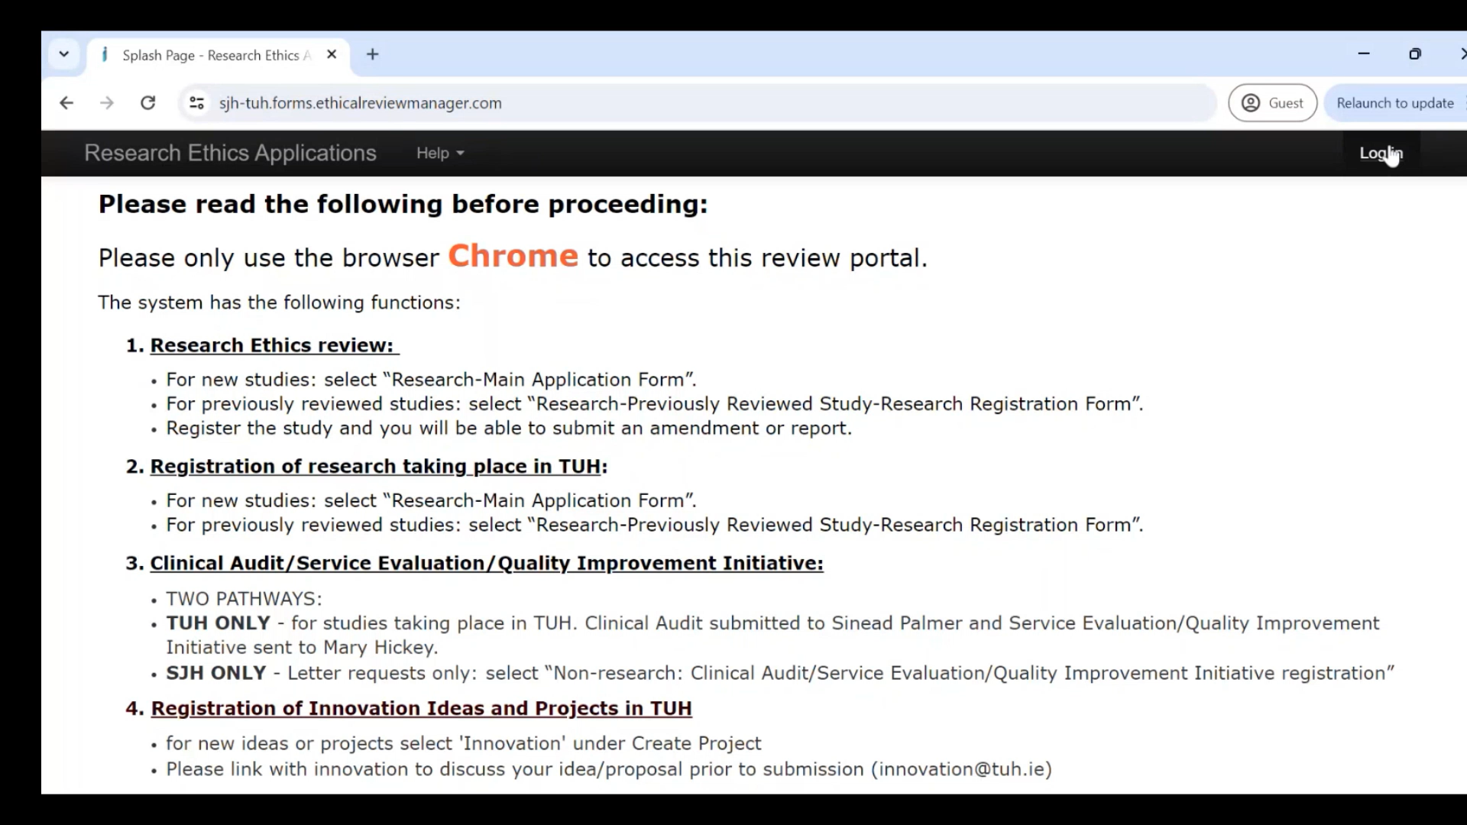

Creating a Pathway 1 application (Jrec and R&I application)
Log in to your Infonetica account
Select ‘Create Project’ from the Action Pane on the left
Select ‘SJH/TUH Research Registration and JREC Form’
Create and complete your JREC form
Create your R&I sub-form

Slide 16
Pathway 2
Pathway 2 is for applications where external ethics can be accepted.
  Low risk studies where the R&I office can accept university or institutional ethics
  High risk studies where external ethics such as NREC and CTIS are required
Pathway two allows applicants to bypass the JREC form and enables applicants to upload their letter of external ethical approval.

Slide 17

Pathway 2: Research Types
High Risk
Requires NREC / CTIS
Clinical Trial
Medical Device Trial – Subject to medical device regulations
Low risk
University/ Institutional accepted
Staff study
SJH as a site of advertisement only
Multi-site ionising radiation trial – where the first site has ethical approval in place
Case study - less than 5 patients (ethics not required)

Slide 18
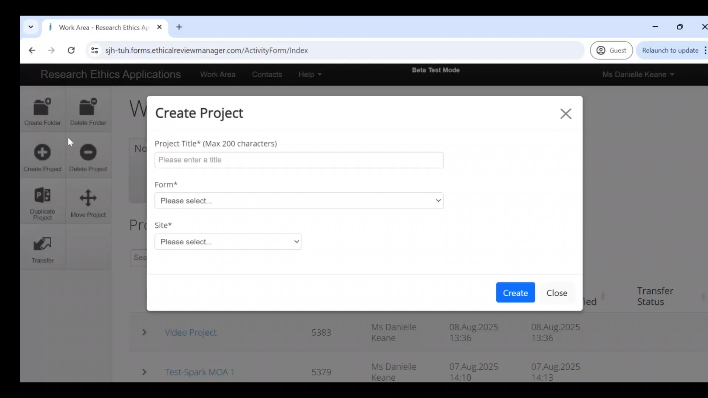
Creating a Pathway 2 application (upload external ethics)
Log in to your Infonetica account
Select ‘Create Project’ from the Action Pane on the left
Select ‘Pathway 2 Case Studies <5 patents, Staff Studies & regulated clinical & Medical decice Trials’’
Complete your R&I form

Slide 19

Creating and Completing your R&I application
Pathway 1 Application Sections
Pathway 2 Application Sections
Successfully Submitting your R&I Application: 3 steps

Slide 20
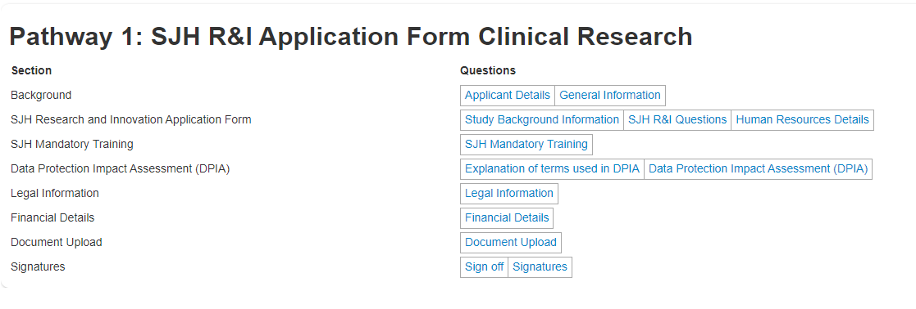
Application Sections: Pathway 1

Slide 21
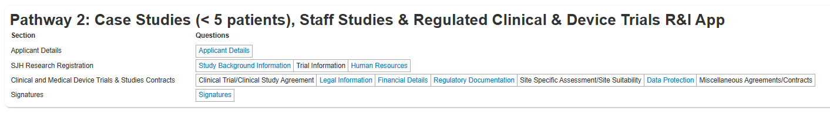
Application Sections: Pathway 2
Some sections depend on the study type.
This application was not a trial, so the trial specific questions stay ‘locked’

Slide 22


Submitting your R&I application
Once you have completed all questions in you R&I application you must submit the application for review.
There are three steps:
The applicant signs off using their username and password
The applicant requests the PI’s signature using the PI’s user email
The PI reviews the application and signs off with their username and password
YOUR APPLICATION IS NOT SUBMITTED UNTIL THE PI SIGNS OFF.
THE No.1 CAUSE FOR DELAYED REVIEW AND APPROVAL IS NO PI SIGNATURE ON APPLICATION!

Slide 23
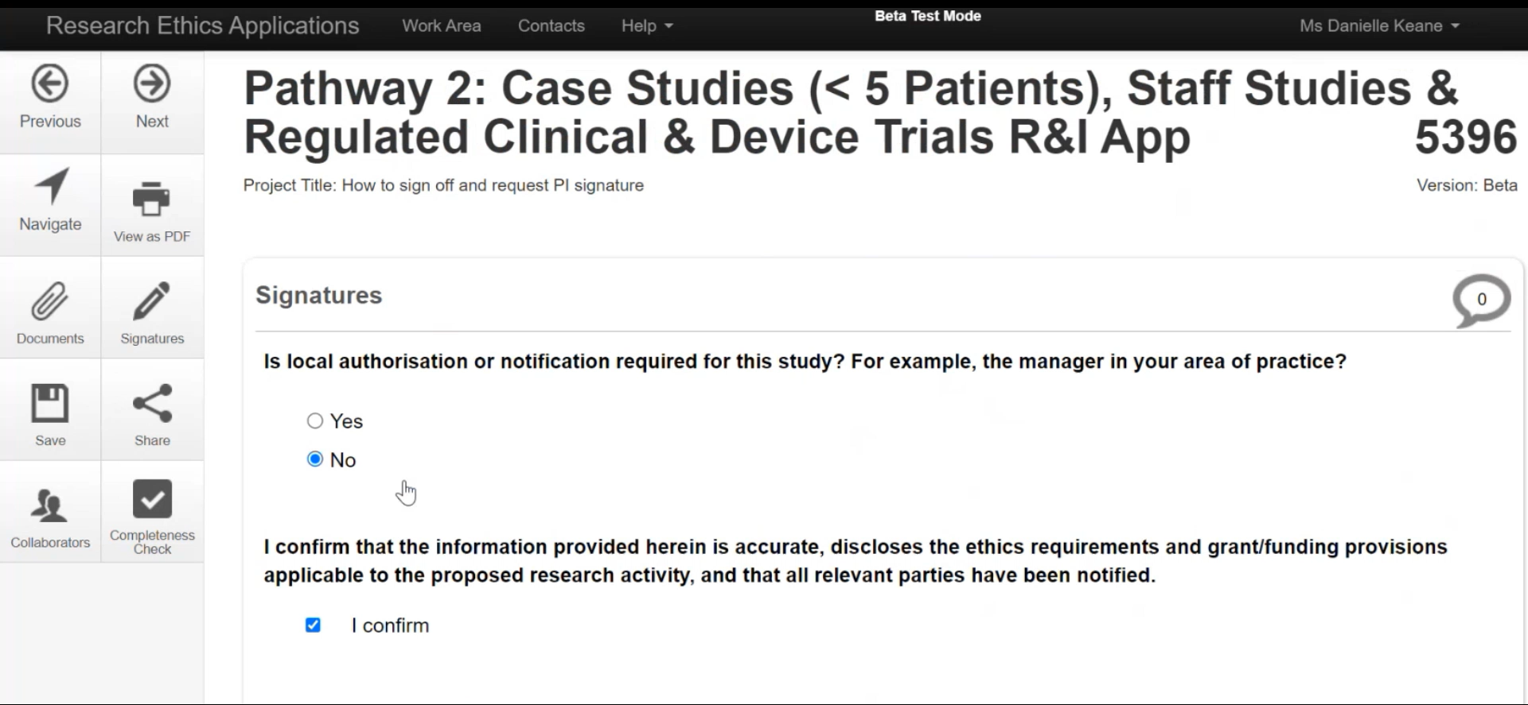
How sign off your application
and request your PI’s Signature

Slide 24
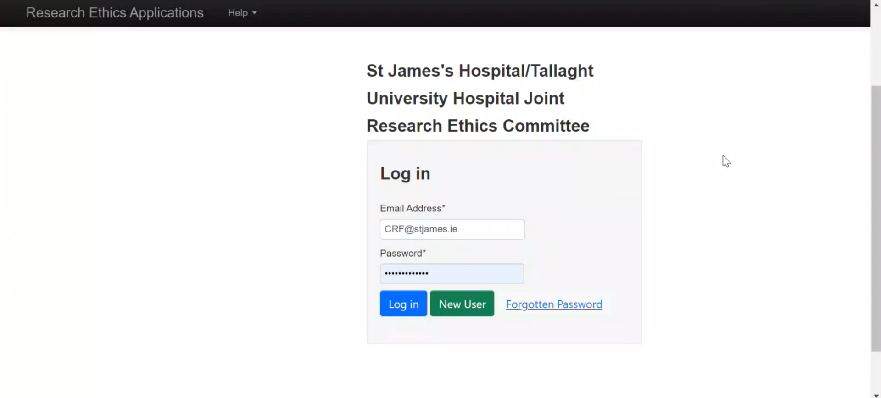
How to Sign off as a PI

Slide 25

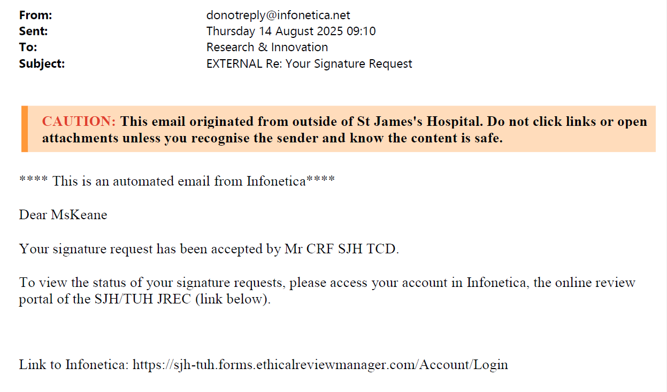
Successful Submission
If you do not receive this email, your application is NOT submitted!
Your PI must accept the signature request and sign off to ensure full submission

Slide 26
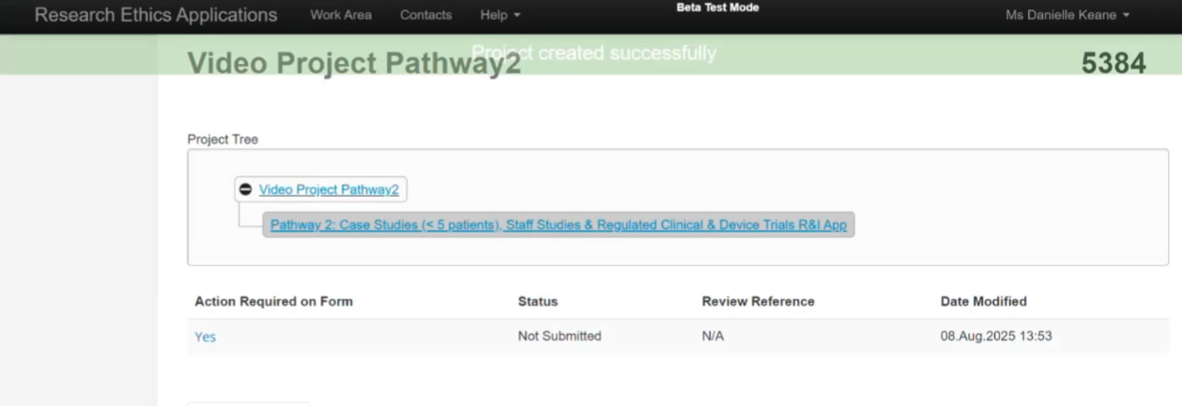
Check your application status at anytime!
Check if your application is fully submitted
Helps you stay updated on your application’s process
Know when your application has been returned with queries/ comments

Slide 27

After Submission
Review Process
Responding to Reviewer Comments on your Application Form
Responding to Comments on Supporting Documents
R&I Approval Letter

Slide 28
R&I Application review process
Initial R&I Review
DPO
Optional: CRF/ NRAC
Legal + Financial
CEO
Final R&I Approval

Slide 29
Initial R&I Review
Optional: CRF/ NRAC
DPO
Initial review of application, minor errors in DPIA can be resolved at this point.
Data Protection Officer reviews the Data Protection Impact Assessment (DPIA) of your application. Often applications will be returned with comments and queries
Only required if the project is being run in the Clinical Research Facility or if Nurses or HCAs are participants in the study and review is required by the Nursing Research Access Committee (NRAC)

Slide 30
Legal + Financial
CEO
Final R&I Approval
Contracts are reviewed by both Legal and Finance.
Your application will not be approved by the legal department without ethical approval uploaded.
Your application will be returned to you at this point for ethics upload
CEO reviews all research taking place on campus
Final approval is granted by the R&I Programme Manager – your project may only proceed when you receive final approval

Slide 31
Addressing comments/ feedback
Reviewers can leave comments and request further information; you will be notified via email.
The application will be returned to you and unlocked for editing
You must address all comments before resubmitting to avoid delays in processing.
Comments that are not addressed will be returned to you again

Slide 32
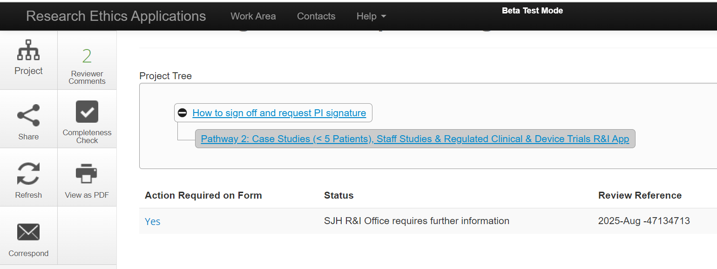
Addressing comments/ feedback
When a form is returned with comments, the status will change to indicate information is required.
‘Action Required’ will state yes as you are required to address comments.
To view the reviewer comments, click ‘reviewer comments’ in the action pane. Clicking on the individual comments will bring you directly to their location within the form

Slide 33
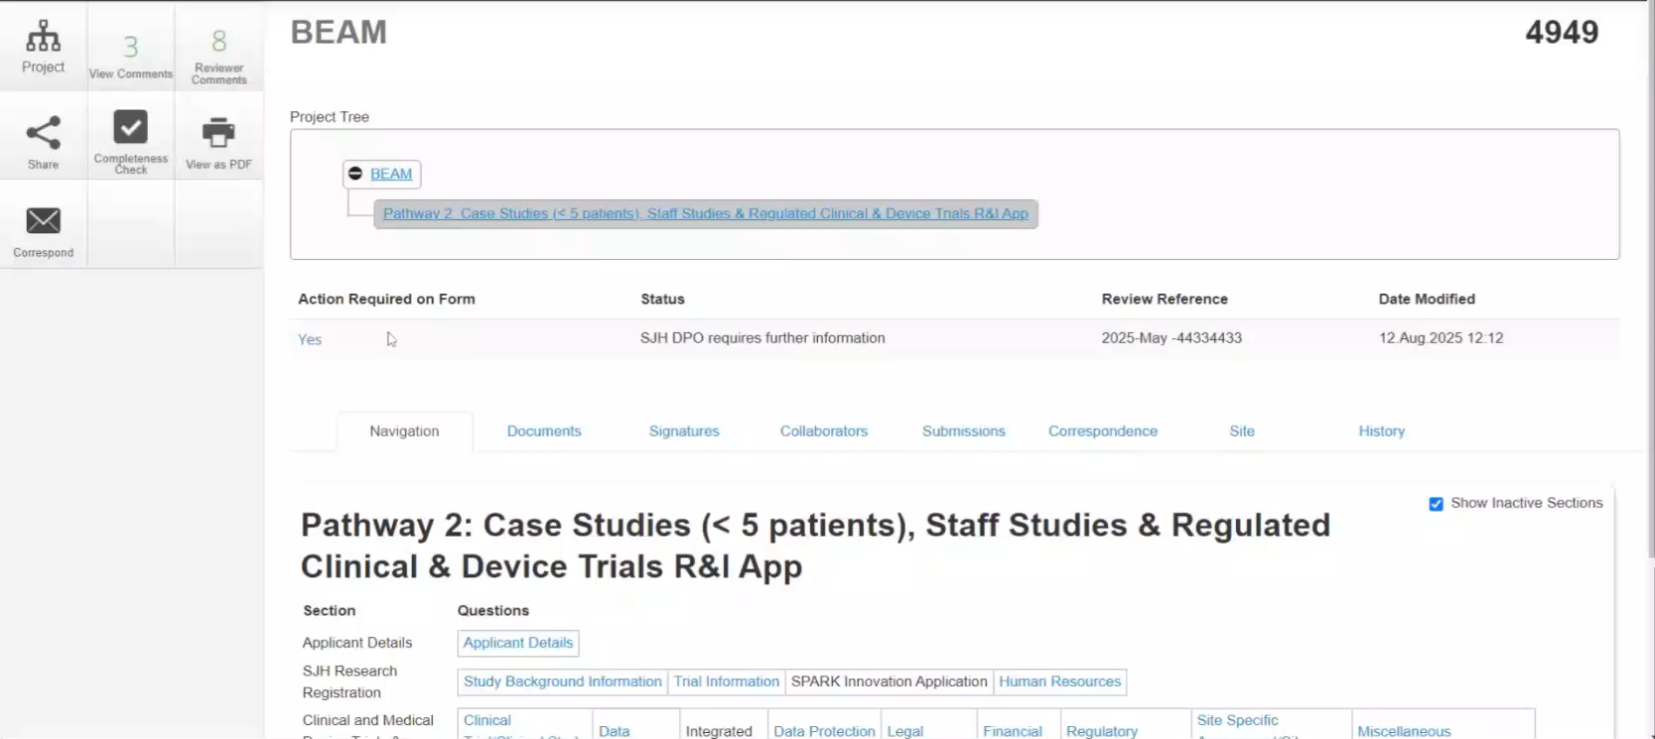
Addressing comments/ feedback

Slide 34
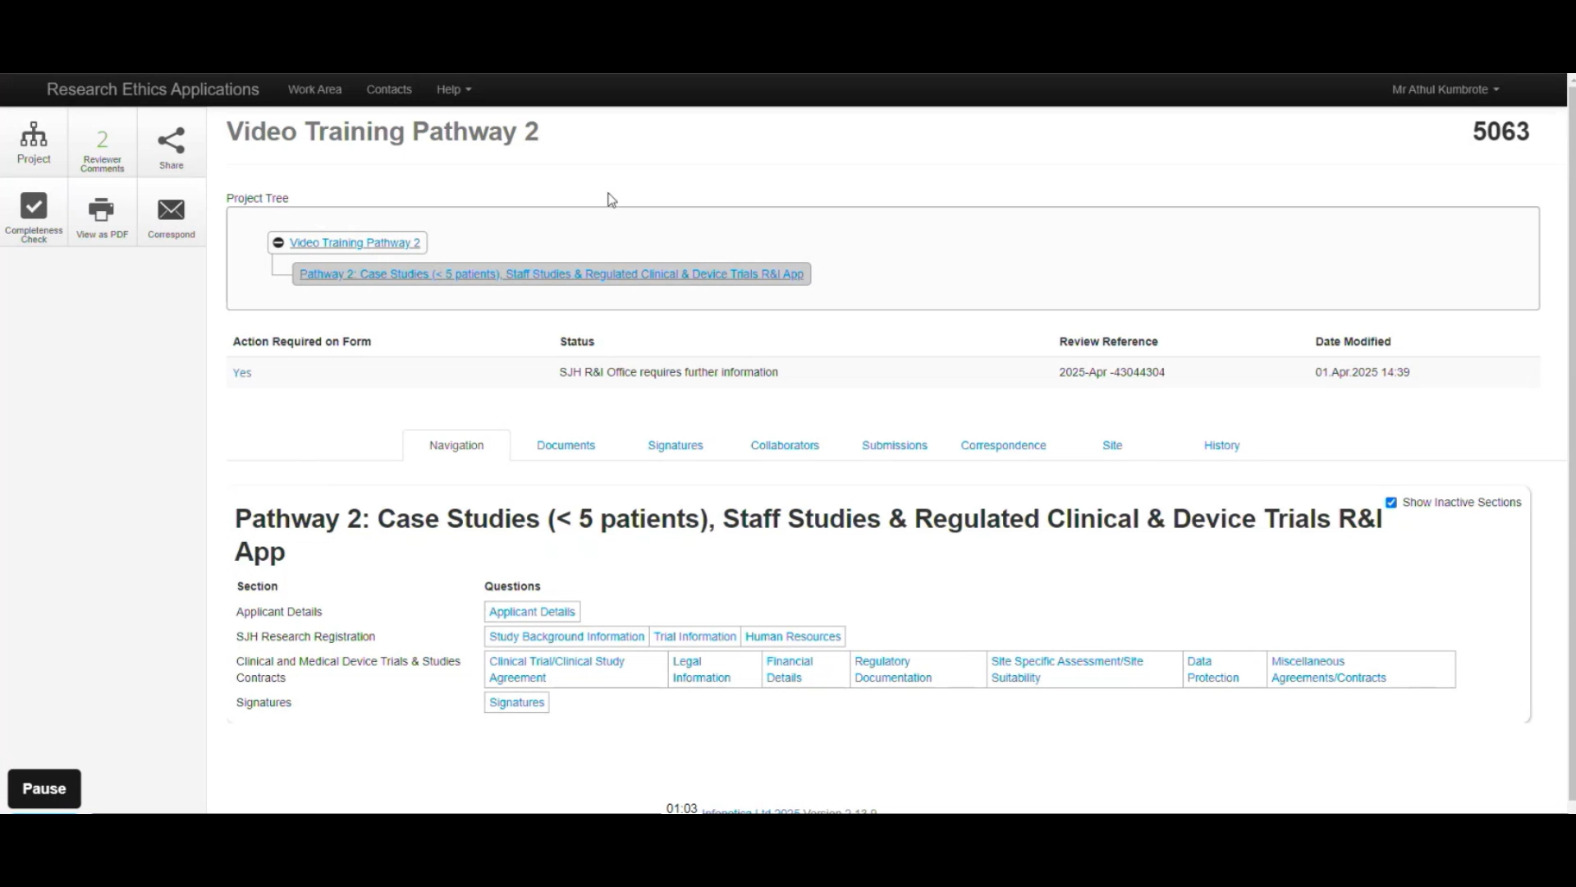
Comments on supporting documents
Supporting documents are also reviewed and may be returned with feedback.
Documents are returned with comments via correspondence
The applicant must download the document, address the comments and re-upload the document as a correspondence

Slide 35
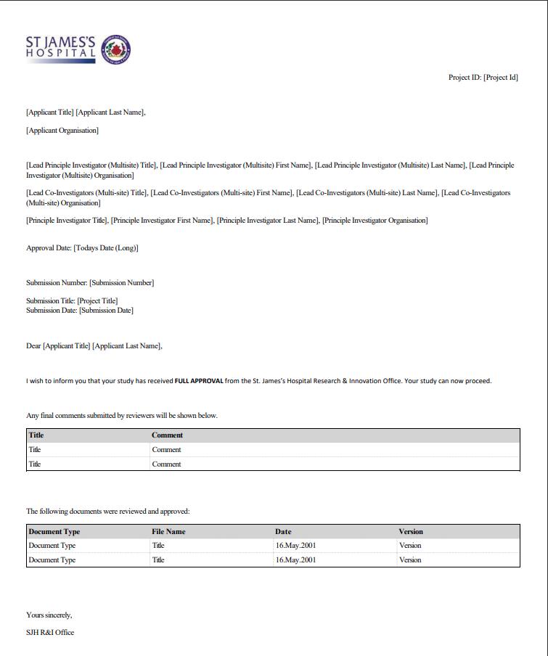
Example:
Letter of R&I Approval
You do not have permission to proceed until you have received this letter of R&I approval
This is the only accepted proof of approval.

Slide 36

Key tips

Slide 37

Reminder:
  Pathway 1 – JREC + R&I application
  Pathway 2 – External ethical upload within R&I application
When checking the status of your application or addressing comments, ensure that you have selected the R&I application branch of your project tree
Data Sharing Agreement, Participant Information Leaflets and Informed Consent Form templates are available on Infonetica – click ‘help’ on the top bar and select ‘templates’ from the drop down
We will accept DPIAs on sponsor templates – you can upload these directly to the application
You can submit your application while your ethics is still pending!

Slide 38
Upcoming Events
October: Research Clinics
Research Winter School
Staff Conference -– December 12th, 2025

Slide 39
Useful Links
Link to publications on R&I page
Link to funding information on R&I page
Good Clinical Practice (GCP) Training
R&I Application Guidance Manual
R&I Application Guidance Videos

Slide 40
Thank you!
Questions?
research@stjames.ie

